Slide 1
Information Session on 2025 Technical Reporting
Portfolio Performance Unit (PPU)
29 July 2025

Slide 2
Agenda
Technical Reporting Arrangement 2025-30
Technical reporting priorities for 2025
What
Annual Technical Reports
Performance and Reporting Management System (PRMS)
Quality Assurance
When
Technical Reporting timeline
How
Resources
Engagement plan
Process for PRMS enhancements
What next
Upcoming activities

Slide 3
Technical Reporting Arrangement (TRA) 2025-30
Approved by the CGIAR Global Leadership Team on 5 June 2025, provides the operational basis to plan, monitor, learn, and report on the 2025-30 Portfolio.
It is designed to progressively enable Programs and Accelerators, Centers and their research teams to report on the pooled and W3/bilateral projects of the 2025-30 portfolio in an integrated and aligned way, without increasing reporting burdens of Centers and scientists.
Main changes compared to 2022-24 TRA:
Streamline reporting (less products, more integration, lower transaction costs).
Stronger impact-focus: results to be clearly linked and packaged under impacts, outcomes and associated agreed indicator targets.
Better linkage between annual Program/Accelerator Theory of Change, Plan of Results and Budget, and Technical Reporting.
The primary audiences for Technical Reporting are Funders and CGIAR staff at Integrated Partnership, Portfolio, and Program/Accelerator Levels. The secondary audience is Partners.
Annual Technical Reporting covers individual Program and Accelerator progress towards their respective end of delivery outcomes, as well as provide an overall Portfolio view of aggregate contribution to thematic and geographic targets.
Relevant content from Technical Report products will be integrated into CGIAR’s corporate reporting.

Slide 4
2025 Technical reporting priorities (transition year)
The TRA will be implemented through a phased approach, with the first phase focusing on streamlined reporting and stronger linkages across Program/Accelerator ToCs, PoRBs, MELIA and technical reporting. Key deliverables in this initial phase include:
Delivery of 2025 Program and Accelerator Technical Reports by April 2026.
Delivery of the 2025 Portfolio Narrative by June 2026.
Integration of the top 80% of W3 and bilateral projects (by Center portfolio value) into Program/Accelerator ToC, MELIA, PoRBs, and Technical Reporting.
Application of the initial Minimum Data Standard, proposed by Center MEL Focal Points and approved by the GST, to guide the integration of the top 80% of 2025 W3/bilateral results into Program,/Accelerator, and Portfolio technical reports.
Review and refinement of W3/bilateral project mapping during the Pause & Reflect process, with recommendations submitted to the GST for approval.
2025 - a transition year toward KPI-based planning and reporting: efforts are underway to enable planning and reporting at the KPI level, aligned with System Office (SO) objectives and key results (OKRs) for 2026 and 2027 (TBC):
2026 OKRs:
100% of Program/ Accelerator work plans and budgets (by Q1 2026) and annual technical reports (starting with the 2026 reporting cycle) provide for software-enabled monitoring of performance and results against SMART key performance indicators (KPI) by Center, year, and W1/2 funds invested.
80% of Centers’ CGIAR Trust Fund Window 3 (W3) and bilaterally funded work (by value) included in 2025 technical reports (by Q2 2026).
2027 OKRs:
80% of Programs’/ Accelerators’ 2030 outcomes are on track to be delivered or exceeded (by Q4 2027).
90% of Centers’ W3 and bilaterally funded work (by value) included in 2026 technical reports (by Q2 2027).

Slide 5
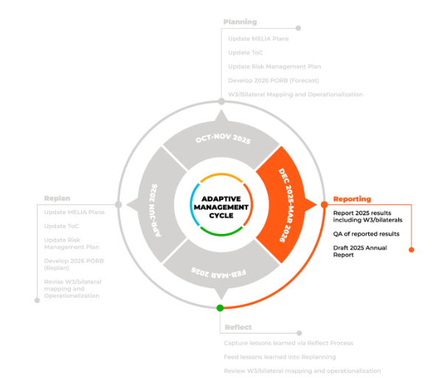
2025 Technical Reporting
WHAT
Program/Accelerator deliverables
Reporting results in the Performance and Reporting Management System (PRMS)
Each Program, Accelerator and mapped W3 project will report 2025 results.
Programs/Accelerator are strongly encouraged to report results that were planned and budgeted, as the updated technical reporting system will allow for tracking results against plans.
QA of reported results
2025 Results will be quality assessed following a defined process and timeline.
QA’ed results will be available on the CGIAR Results Dashboard and inform the Pause & Reflect and the technical reports.
Drafting and submission of the 2025 Annual Technical Report
Each Program and Accelerator is responsible for drafting and internally validating/quality assessing their 2025 Annual Technical Report before submitting it to the PPU.
To support this process, an AI-generated V0 draft - including pre-filled text and analytics for each report section - will be provided as a starting point.

Slide 6
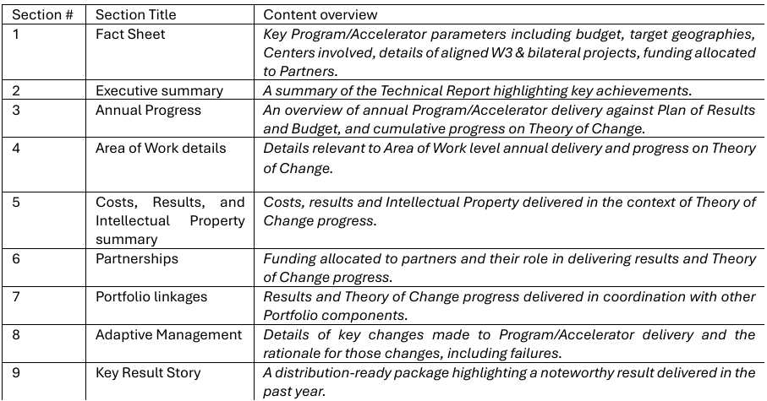
Annual Technical Reports
WHAT
Annual Technical Reports provide assurance on annual Program/Accelerator delivery against PORBs and progress on TOC.
They are short (20-30 pages), concise and targeted.
Based on QA’ed results.
Annual Technical Reports to be submitted by each Program/Accelerator in March/April 2026.
Publication end of April/beginning of May.
Template, guidance, and automatically generated AI-supported content will be provided.
The following content areas are proposed for inclusion: ➔
2024 reports for reference:
CGIAR Impacts in Agrifood Systems: Evidence and Learnings from 2022-24 (Type 2) report is available here
2024 Portfolio Narrative report is available here
The 2024 Initiatives, Impact Platforms and Science Group Projects annual technical (Type 1) reports are available here

Slide 7
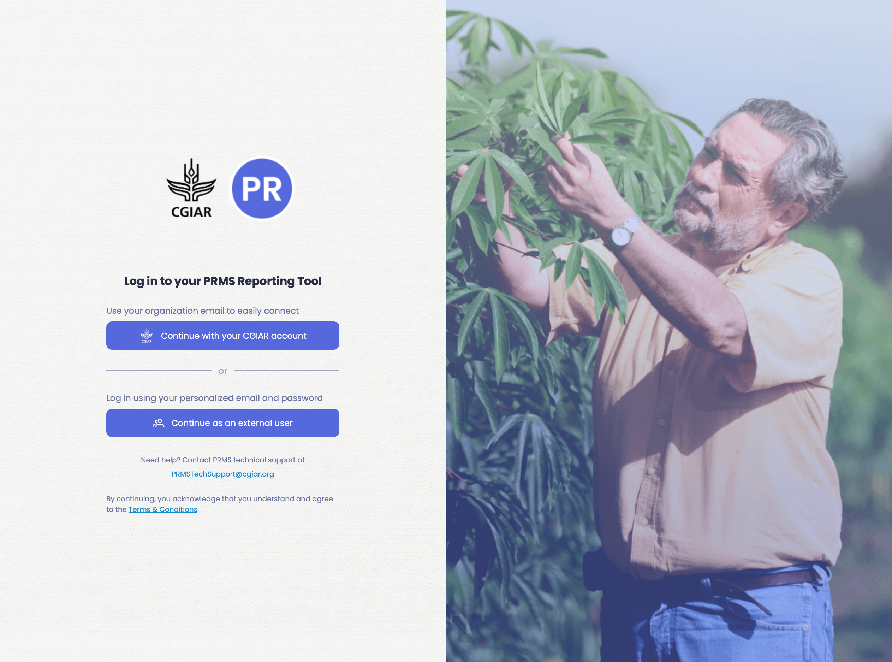
PRMS Reporting Tool
WHAT
PRMS REPORTING TOOL
PRMS roles
PRMS resources: new users onboarding materials

Slide 8
Quality Assurance process
WHAT
Results submitted by P/As in the PRMS will be quality assessed (QA) by a QA team in February 2026.
Your participation in this process is required.
Guidance and resources will be provided.
An info-session will be scheduled.
What is QA?
A process that aims to:
Improve quality of reported data
Provide consistency across the system
Ensure reliability of reported results
Inform a solid learning process
Improve overall CGIAR accountability and transparency
QA’ed data informs:
The Reflect process
Results Dashboard
Annual report content
Portfolio Narrative
Overall CGIAR Annual Report

Slide 9
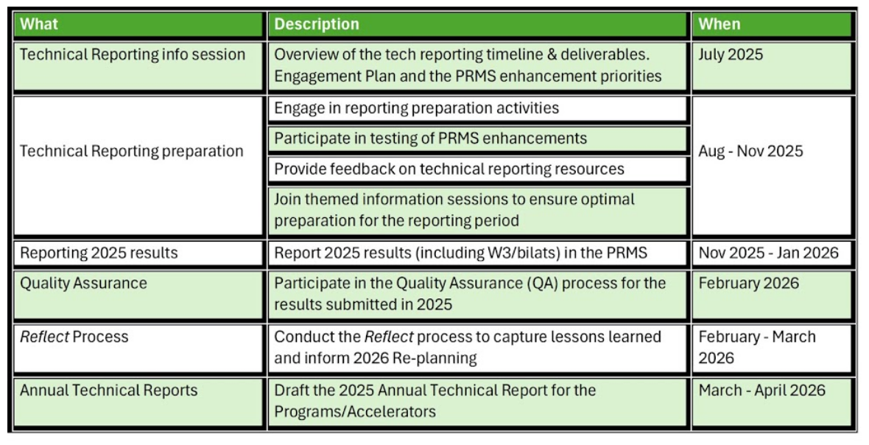
2024 Technical Reporting
WHEN
High Level Technical Reporting timeline

Slide 10

Technical Reporting resources
HOW
The P&R hub: your One-Stop Shop for Planning, Technical Reporting and MELIA information.
Latest updates
Timeline
FAQ
Guidance documents
Reference documents
Report templates

Slide 11
Technical Reporting engagement plan
HOW
Support period: July 2025 – June 2026
Purpose: Streamline communication and optimize support for Programs, Accelerators, and Centers with mapped W3/bilateral projects
Technical Reporting questions: performanceandresults@cgiar.org
PRMS support: prmstechsupport@cgiar.org
Info-sessions
Frequency: Limited (at key milestones)
Focus: Specific topics (e.g., indicators, tools, QA, report template)
Drop-ins
Frequency: As needed, based on input from the Core Engagement Group
Focus: Open Q&A, clarification, live support, with primary focus on the reporting and QA period
Update emails
Frequency: Every 2 weeks
Focus: Key updates, reminders, Q&A summaries
Targeted emails/feedback
Frequency: as needed
Focus: engage specific categories within the P/As, based on technical reporting revisions/developments, to gather targeted feedback. Program Coordinators will be copied on these emails.
*Microsoft Teams chats will be activated only during scheduled meetings and closed immediately after. performanceandresults@cgiar.org is the official communication channel.
The Performance and Results (P&R) Hub will serve as the central repository for all materials related to Technical Reporting.
Full engagement plan available via the P&R Hub and here: Full engagement plan.

Slide 12
PRMS enhancements and feedback process
USER TESTING
Sounding Board tests proposed PRMS update
FEEDBACK AND DEVELOPMENT
Feedback reviewed
PRMS Tech Team develops update
DEPLOYMENT
Update tested and deployed
Update becomes available on the PRMS platform
DOCUMENTATION AND COMMUNICATION
Notion page published detailing latest update
Fortnightly emails and P&R Hub used to communicate changes
HOW
The Sounding Board will consist of:
PRMS Tech Team
PCU Team
PPU Team
Specific categories within PMUs

Slide 13
Upcoming activities
WHAT NEXT
Biweekly technical reporting updates – first email out on 31 July.
Targeted engagement calls for PRMS testing.
Info sessions on specific topics (e.g. QA, innovations reporting, PRMS, 2025 annual technical report, etc.).
Engagement on W3/bilateral – Jules Colomer is leading on this together with the Alignment working group.

Slide 14
TOC dashboard
Result Framework - ToC Dashboard - Power BI
Review and flag errors by email to performanceandresults@cgiar.org

Slide 15
Thank you!
Useful resources
Performance and Results hub
Technical Reporting Arrangement 2025-30
Results Dashboard
2024 Technical Reports

